Slide 1
Meta Cities - City Regions H G Wells (1902, 8th edition) Anticipations, Chapman & Hall, London Chapter II, The Probable Diffusion of Great Cities
‘Enough has been said to demonstrate that old “town” and “city” will be in truth, terms as obsolete as “mail coach”. For these new areas that will grow out of them we want a term, and the administrative “urban district” presents itself with a convenient air of suggestion. We may for our present purposes call these coming town provinces “urban regions”.’ (pp60-61)
‘… the city will diffuse itself until it has taken up considerable areas and many of the characteristics, the greenness, the fresh air, of what is now country, leads us to suppose also that the country will take to itself many of the qualities of the city. The old antithesis will indeed cease, the boundary lines will altogether disappear; it will become, indeed, merely a question of more or less populous.’ (pp63-64)

Slide 2
Meta Cities - City Regions H G Wells (1902, 8th edition) Anticipations, Chapman & Hall, London Chapter II, The Probable Diffusion of Great Cities
Wells describes more or less precisely the reality of our large cities and agglomerations at present:
The diffusion of the city is made possible by fast transport systems that allow an hour’s commuting time to carry people 100 miles and more
The diffusion will be lead by those classes that are free to have a choice, but the considerable diffusion that will thus be generated will draw the “working” classes out as well (p48 and p56)
There will be a considerable diversity in suburban townships and districts, segregating various types of people (p55)
Subsidiary centres will accommodate doctors and teachers, retailers, traders etc. and will provide local services and facilities (p56)
As a result of advanced communication systems, many people will work from home (p57); goods and services will be ordered from home (p59)

Slide 3
Meta Cities - City Regions H G Wells (1902, 8th edition) Anticipations, Chapman & Hall, London Chapter II, The Probable Diffusion of Great Cities
The less densely developed regions will be wooded, breaking continually into park and garden, and houses will be scattered everywhere (p61)
Agriculture will be part of the urban region (p62)
The city will be taking on characteristics of the country, the country characteristics of the city; there will be no more boundary lines between city and country (pp63-65)
The arguments I would like to raise here are:
that we do understand that this diffusion of the great cities has happened
but that today we are still largely pretending that the urban region can be managed and planned as consisting of separate and semi-independent towns and cities (the current planning system)
or that we ought to return to the compact European city, i.e. reverse 100 years of urban diffusion

Slide 4
Meta Cities - City Regions H G Wells (1902, 8th edition) Anticipations, Chapman & Hall, London Chapter II, The Probable Diffusion of Great Cities
I will argue that we need to accept the city region as reality the reversal of which into a number of compact cities would be socially unacceptable and economically unmanageable, that we therefore need to find new urban planning and urban design approaches that deal with the meta city
I will also argue that there might be benefits in doing so; thoroughly investigating the ways in which the city region could be planned, designed and managed to become more sustainable, we may find that what could be achieved is viable and worth the effort
This contribution is fuelled by years of research that has recently been enriched by discussions with Professor Thomas Sieverts in Germany (who’s book “Zwichenstadt” (meta city) will be published in English by SPON this year) and by his recent book on 50 years of urban design in Europe.

Slide 5
The development of the city region
In the 19th century, the city started to expand along railway lines: the star city
Catalyst: railway transport

Slide 6
The development of the city region
With mass car ownership the city expanded into the areas between the star city’s fingers and beyond
The core area changed into a commercial and administrative centre, surrounded by a ring of transport infrastructure
Living areas took on the form of single use, low density suburbs
Soon, functions hitherto located in the city centre moved out into less congested areas with better access, forming secondary core areas
A typical example: the USA city

Slide 7
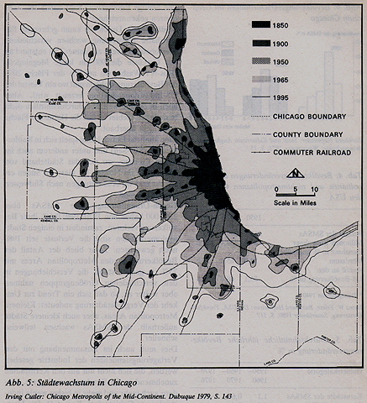
Räume und Strukturen, Fundmente, Ernst Klett Verlag, Stuttgart, p.405

Slide 8
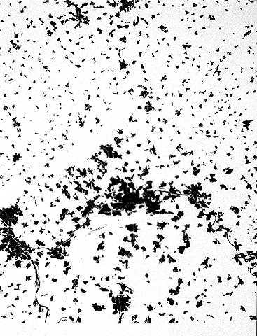
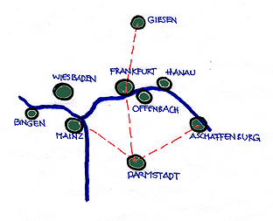
Rhein-Main Area

Slide 9
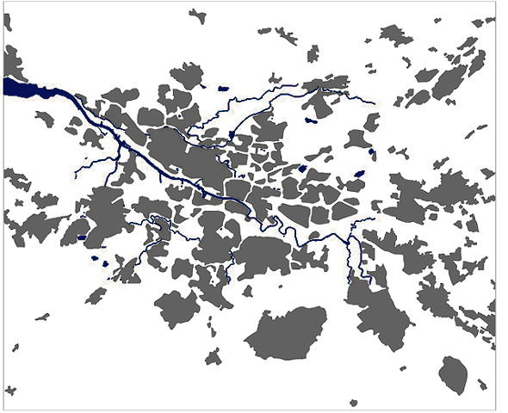
Greater Glasgow

Slide 10
The ‘city’ is the region
The political boundaries of a ‘city’ have become detached from the reality of the city region that represents a continuous network of socio-economically interactive and interdependent clusters of urban fabric linked by a shared infrastructure
Population is diffused: people move away from large centres to smaller towns and rural areas
Räume und Strukturen (1998), Fundamente, p385

Slide 11
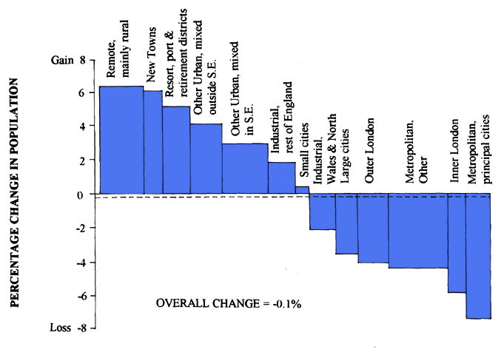
Jenks-p59
Trend of decentralisation by 1992: residential population and employment in Britain’s major cities
Is shifting to smaller provincial towns and villages (Source:Blowers, 1993)

Slide 12
Functionally diffused ‘city’
commercial and industrial uses move into locations with good transport infrastructure (at expressways, motorways)
people opt for locations away from concentrations and major transport routes
there are two separate ‘cities’: the ‘hard’ network of commercial & industrials nodes and transport infrastructure; the ‘soft’ suburban living quarters in between

Slide 13
Functionally diffused ‘city’
Consequences of functional diffusion : the need to be highly mobile
a growing difficulty of those not so mobile (the elderly, the young mothers with children, the disabled, those without a car etc.) to gain access to services and facilities
there is growing inequity of mobility and access

Slide 14
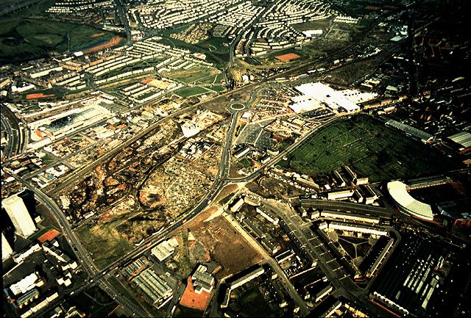

Slide 15
Changing social patters
The household structure is changing: there are less and less ‘nucleus’ families and more and more single person and single parent households
Consequently, there is a steady increase of personal space (e.g. in Germany: an annual increase of gross floor area between 0,5 and 1,0 m2 per person)
The built-up areas expand although population is stable
As a result of urban expansion, there is more and more loss of the countryside
As a result of people moving away from old centres, growing personal space, and a change from ‘social responsibility’ (the welfare state) to ‘personal responsibility’ (the enterprise state) there is a growing loss of social solidarity and equity
Urban development is less and less a public responsibility

Slide 16
Changing social patterns
“We live in an era of material abundance, but we have a scandalous inequity of the distribution of societal wealth. How we deal with with this phenomenon will say much more about the Europeanness of our cities than the question what we will do with city form.”
(Sieverts. T. (2001) Fifty Years of Urban Design, Hohenheim Verlag, Stuttgart-Leipzig, p.218)

Slide 17
Changing work patterns
People have more leisure time - more mobility (going on holiday)
People work from home - less mobility (no need to go to a central work place except perhaps once a week)
As a result of changing work patterns, people have more than one job - more mobility (changing place)

Slide 18
Consequences of change
The consequence of changing social and work patterns is a demand for a more adaptable ‘city’ and for a more adaptable urban fabric
the ‘city’ cannot any longer be seen as a ‘formal product’ but a continuously changing entity as a result of continuously changing socio-economic processes
Many of the forces behind these processes effect a dissolution of the city
We clearly cannot continue to pretend that we are still dealing with ‘city’ as clearly definable entity
The call for the compact European city is nostalgic; it exists only in the historical cores of old centres which have largely become commercialised, i.e. have lost their social attraction as a result of the loss of the mixture of uses and activities that once resulted from people living there

Slide 19
The call for a sustainable urban form
The sustainable city is largely believed to be
Compact and dense (although the majority of people prefers low density living areas)
Mixed use (although living, working, commerce and recreation / entertainment have separated out into different and spatially clearly separated ‘cities’)
Public transport (although its infrastructure has been starved almost to death over the last decades and although car mobility is still promoted by politicians (road building programmes, car parking
regulations) and businesses (company car)
Socially inclusive (although there is a clear move away from ‘social welfare’ to ‘personal welfare’
The only sustainability parameters that are not contentious are:
Reduction of energy use and waste
Reduction of pollution
Reduction of the use and wastage of material, of the production of waste
The need to establish a symbiotic relationship between ‘city’ and ‘country’

Slide 20
New principles of urban design
“The question of urban design guiding principles has to be newly asked - in connection with other important unanswered questions of the essence of the political, of the relationship between city and nature, of our relationship with history, of the importance of culture and art, and not least, of course, of the relationship of globalised and local economy and with it the essence of work and employment.”
Sieverts, T. (2001) … p.221
The guiding principles of urban design:
Do justice to an impersonal and opaque globalised economy but generate a local personal field of activities
Provide cultural and social support, safety and security for people
Achieve a Gestalt (formal quality) that is more than the sum of individual, non-correlated projects; the dominance of the market without a common urban design and urban spatial goal will lead to the decay of the city

Slide 21
The tasks ahead
The forming of a new urban landscape
The city is the region
We need integrated policies for agriculture and urban development: the countryside is not outside but inside the city; nature needs to be protected but also become part of city activities
The political subdivision of the city region into competitive ‘cities’ needs to be critically reviewed: no socio-economic balance is achieved in a city region without a joined goal of urban and rural development
Greater Glasgow: the black areas represent
open countryside that is part of the city region

Slide 22
The tasks ahead
The rethinking of the settlements of the ‘50s and ‘60s
These settlements (e.g. our peripheral estates and CDAs) do not represent mere housing and social problems, they have to be seen and dealt with as ‘towns’, urban ‘quartiers’ in need of co-ordinated actions of public and private sector forces to establish social wellbeing of their inhabitants as well as economic and operational viability

Slide 23
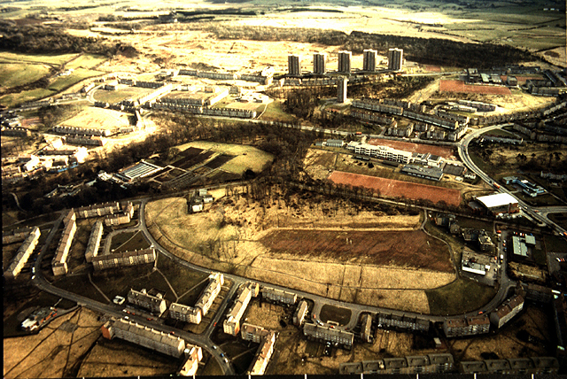
240B20

Slide 24
The tasks ahead
The transformation of the old cores
These areas, because of their commercialisation, don’t work as ‘towns’
People need to move back into them and place can be made by moving functions out that do not need central location
These areas need a new quality of public places
The old cores have to play a cultural role in the sense of a spiritually rather than formally conceived European city tradition

Slide 25
The tasks ahead
The cultivation of the huge technical infrastructure
The transport infrastructure, the network of road and rail based transport, and the services network (sewer, water, power etc.) are the operational lifelines of the city region but are treated as elements apart from rather than part of the city
The infrastructure needs to be formed, and has therefore to become the responsibility of urban design, as much as the urban fabric and nature

Slide 26
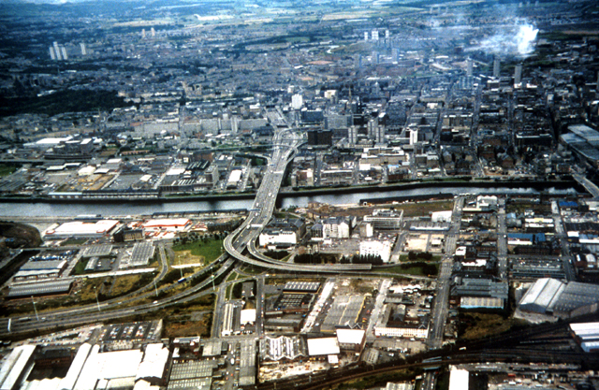
240A26

Slide 27
Conclusions
The range of today’s tasks of urban design is considerably wider than generally acknowledged and practised:
We need to come to terms with and start forming the city region as an entity composed of a multitude of larger and smaller, older and newer development clusters embedded in an open landscape that has to become part of urban design thinking; this includes the forming of the infrastructural network that links all development clusters and makes the city region operationally viable
We need to come to terms with and start forming the settlements of the ‘50s and ‘60s not as a matter of the improvement and renewal of housing stock but as the creation of socially inclusive and economically and environmentally viable ‘towns’
We need to conserve and revitalise historical areas as places of people, culture, art as well as commerce

Slide 28
Conclusions
To achieve all this requires considerable changes of attitude and professional as well as academic practice:
Strategic urban design, at the scale of city regions, cities, towns, districts and urban places, needs to become a generally applied tool of urban planning and development
This in turn requires a change of our educational system and our professional practices; specifically the divide between architecture and planning, or between urban design and urban planning, must be overcome
There must be long-term strategic frameworks for urban development and regeneration, there must be long-term political interest in the city region
Communities must be involved in the process of urban development to a much larger degree than is currently the case

