Slide 1
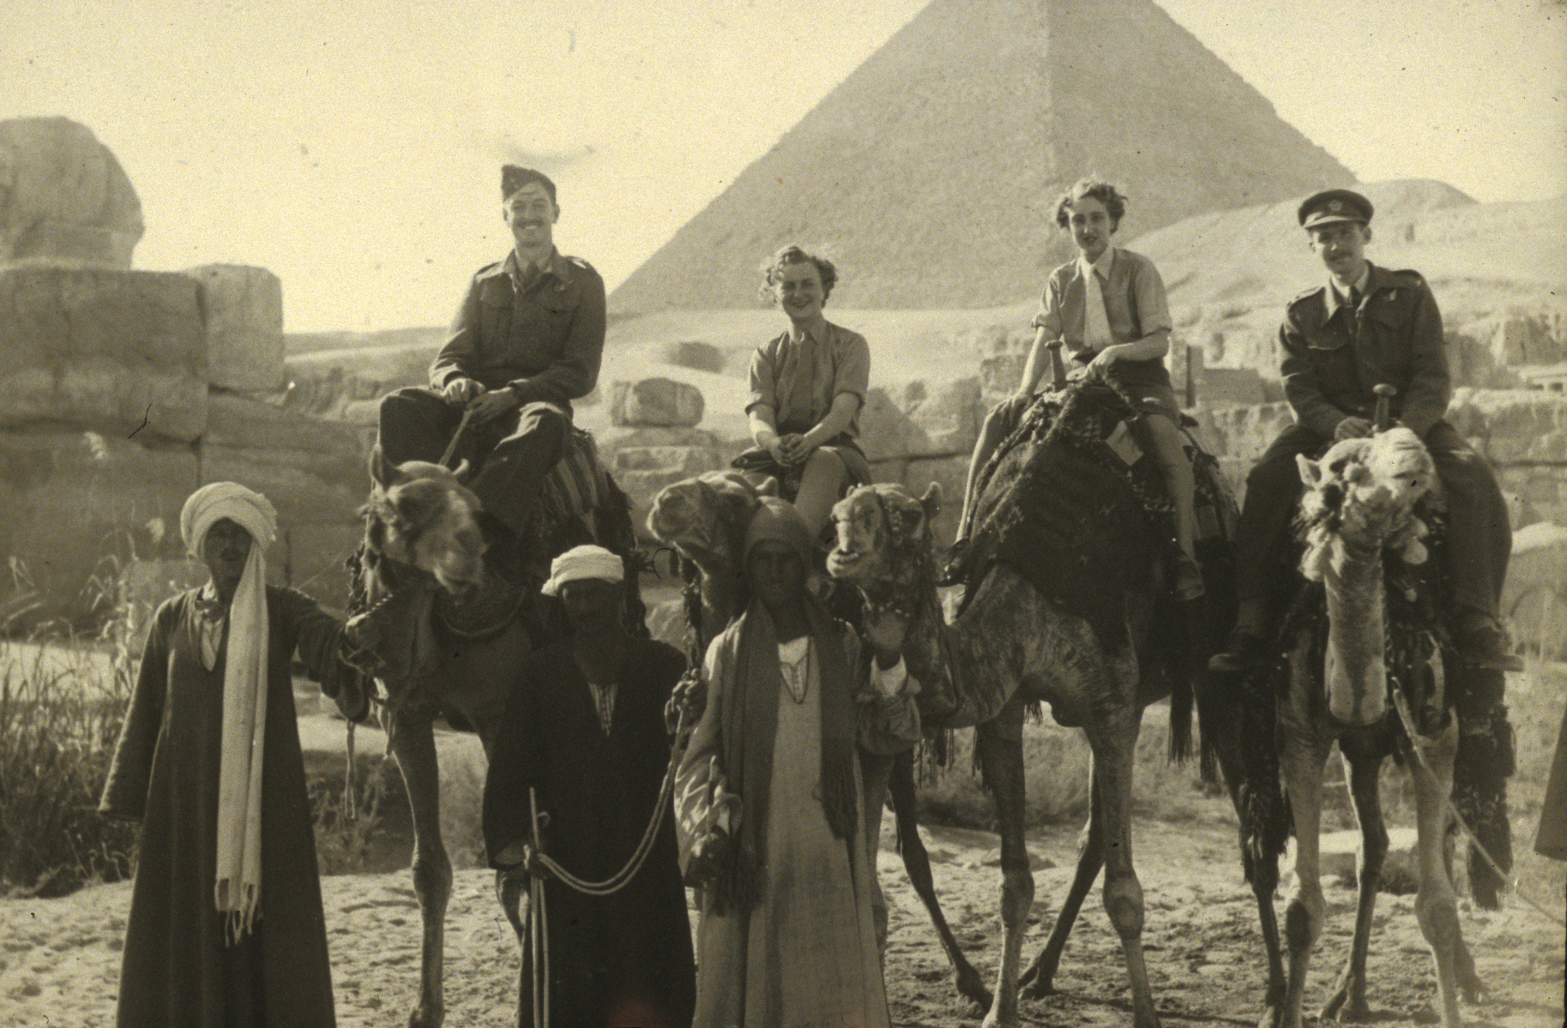
0900 Registration & Coffee
0930 Paul Jowitt Rethinking Urban Design: Introduction
0940 Mark Whitby The Case for Urban Design
Sarah Boyack Interfaces between political decision making,
professionals and people
1050 Coffee
1110 Hildebrand Frey The Meta City
1145 Mike Galloway What we have to do differently
1220 George Paschke Sustainable Construction
1255 Lunch
1400 Murray Woodburn What’s Planning got to do with it?
1435 Herbert Girardet The Metabolism of Sustainable Cities
1510 Howard Liddell Forward to the Past
1545 Coffee
1605 Brian Edwards Global responsibilities and urban design
1640 Robin Nicholson What’s going on?
1715 Close

Slide 2
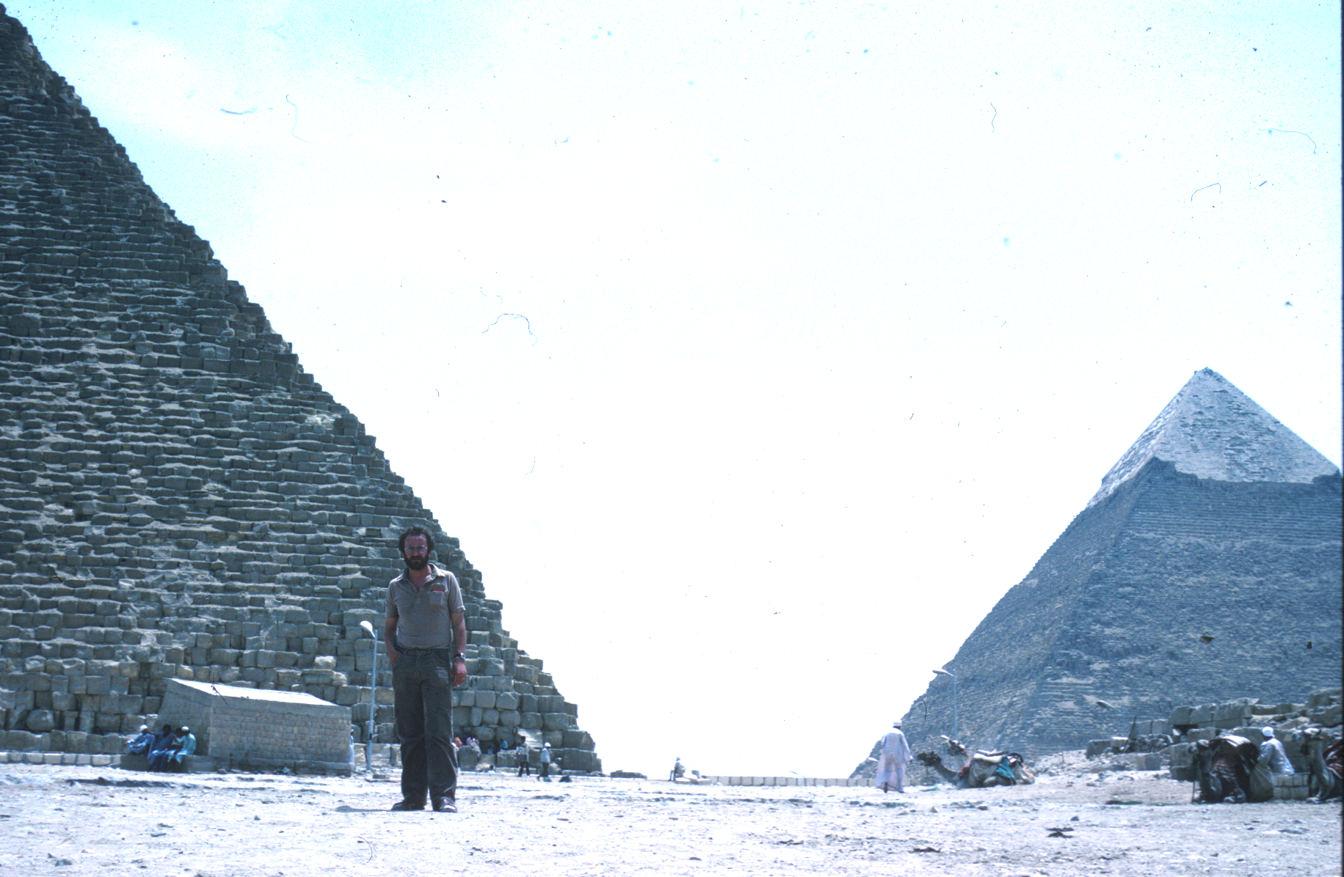
Rethinking Urban Design
Professor Paul W Jowitt
Director:
The Scottish Institute of Sustainable Technology
SISTech @ Heriot Watt University

Slide 3
Footprints?
The Great Pyramid at Giza?
Modern 50 Storey Building?

Slide 4
Footprints? = Weight/Perimeter = W/P
Weight W
The Great Pyramid at Giza?
Modern 50 Storey Building?
Perimeter P

Slide 5
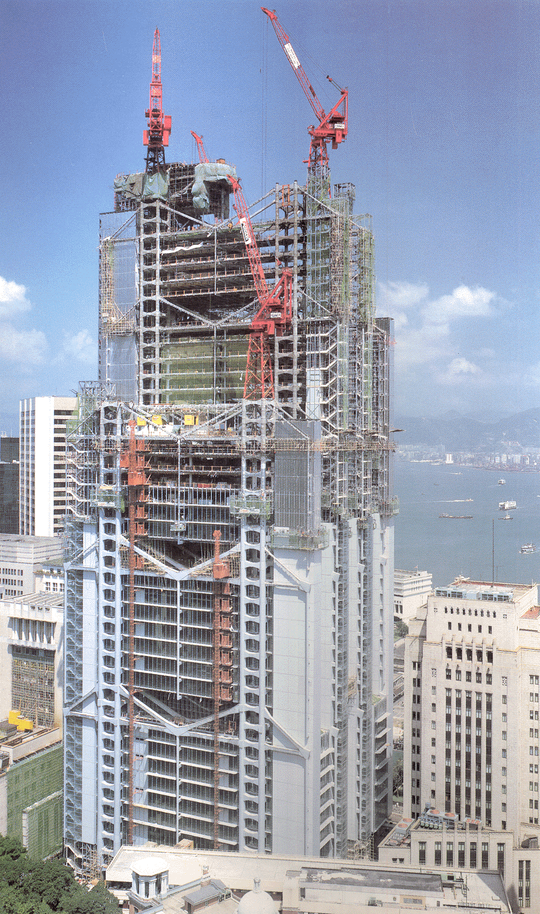
Footprints
W
P
The Great Pyramid at Giza? 70MN/m
Modern 50 Storey Building? 4-5 MN/m

Slide 6
Environmental Footprints?
? Embodied Energy/CO2 Emissions in Construction
? Lifetime Energy/CO2 Emissions
? Construction and Demolition Waste
? Lifetime Waste Generation

Slide 7
The Waste Hierarchy
Waste Minimisation/Reduction
Reducing the amount of waste produced
Reduce
Re-Use
Recycle/ Recover
Disposal
Reduction
Re-use
Using the items again for same or different purposes
Re-use
Recovery
Value recovery through recycling, composting or energy recovery
Recovery
Disposal
Should only be used if none of the other options are appropriate
Disposal

Slide 8
The Urban Design Hierarchy?
Urban Design?
Currently: Artefact/Finance led
Needs to be: People/Resource Inputs/Resources Emissions led

Slide 10
0900 Registration & Coffee
0930 Paul Jowitt Rethinking Urban Design: Introduction
0940 Mark Whitby The Case for Urban Design
Sarah Boyack Interfaces between political decision making,
professionals and people
1050 Coffee
1110 Hildebrand Frey The Meta City
1145 Mike Galloway What we have to do differently
1220 George Paschke Sustainable Construction
1255 Lunch
1400 Murray Woodburn What’s Planning got to do with it?
1435 Herbert Girardet The Metabolism of Sustainable Cities
1510 Howard Liddell Forward to the Past
1545 Coffee
1605 Brian Edwards Global responsibilities and urban design
1640 Robin Nicholson What’s going on?
1715 Close

